Slide 1

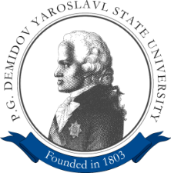


Application of Satellite Image Segmentation for Urban Planning Optimization
ICDPA 2019, May 11-13, 2019 | Shanghai, China
Vladimir Khryashchev, Leonid Ivanovsky, Anna Ostrovskaya, Alexander Semenov

Slide 2
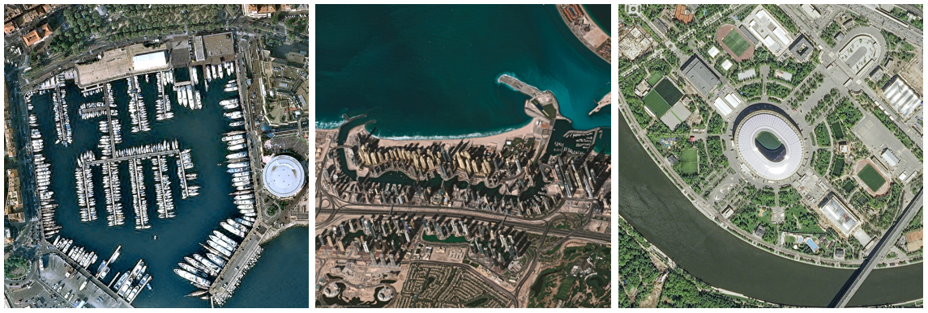
An increase in the training database, the addition of "complex" cases;
Collection of image bases for other endoscopic systems;
Real-time endoscopy processing.
Introduction
Goal of investigation: development of effective algorithm for building detection on satellite images based on deep learning methods
Examples of images from the Pleiades-1B database (spatial resolution of 0.5 m / pixel)

Slide 3


An increase in the training database, the addition of "complex" cases;
Collection of image bases for other endoscopic systems;
Real-time endoscopy processing.
Approaches
Traditional machine learning methods
(k-means clustering, EM-algorithm)
Convolutional neural networks
(SegNet, LinkNet , TernausNet, Fully convolutional networks)

Slide 4
An increase in the training database, the addition of "complex" cases;
Collection of image bases for other endoscopic systems;
Real-time endoscopy processing.
Algorithm requirements
Take into account the small size of objects
Be invariant to rotation
Have enough training examples
Have an ability to handle huge pictures
Cope with noise

Slide 5
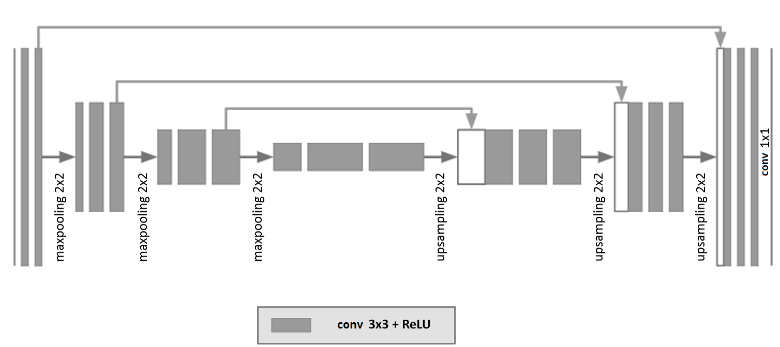
An increase in the training database, the addition of "complex" cases;
Collection of image bases for other endoscopic systems;
Real-time endoscopy processing.
U-Net
Trainable parameters: 7.8 mil
O. Ronneberger, P. Fischer, T. Brox. U-Net: Convolutional Networks for Biomedical Image Segmentation. Medical Image Computing and Computer-Assisted Intervention (MICCAI), Springer, LNCS, vol. 9351, 2015, pp. 234–341.

Slide 6
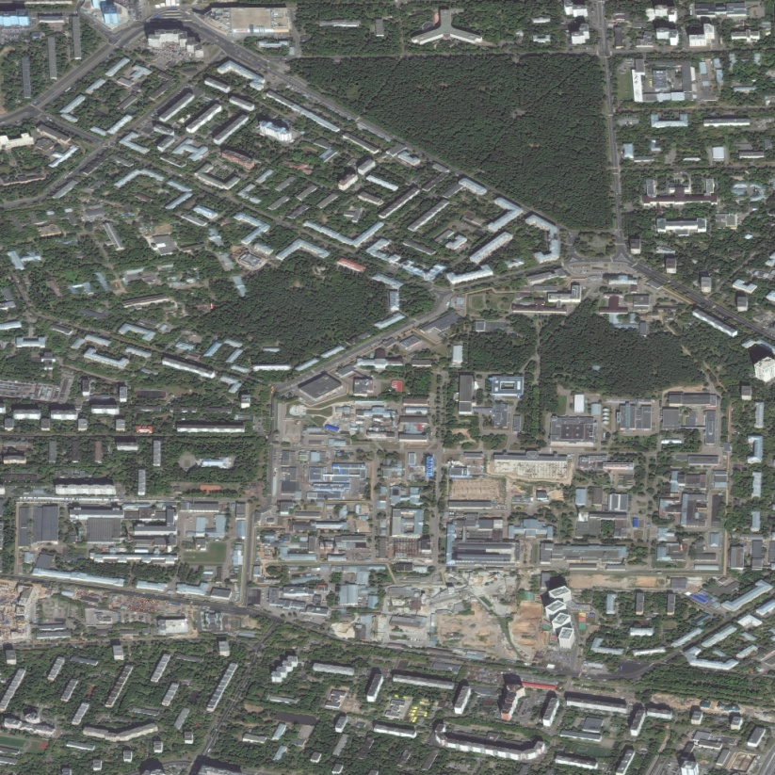
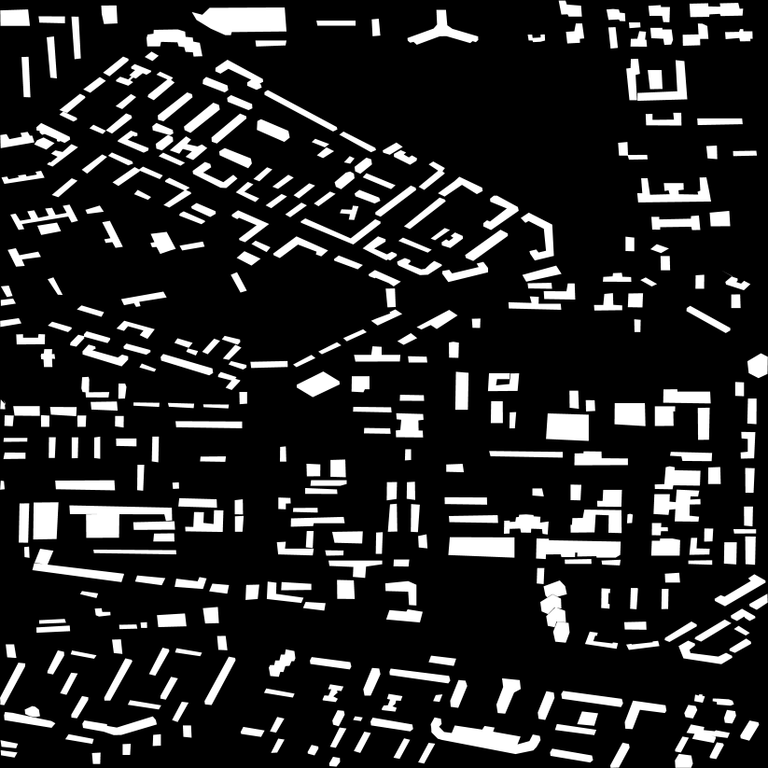
An increase in the training database, the addition of "complex" cases;
Collection of image bases for other endoscopic systems;
Real-time endoscopy processing.
Planet database
14 samples in JPG format
Manual image markup (https://supervise.ly)
Resolution: 8192x8192 px, 0.5 m/pixel
3 Russian cities: Moscow, Yaroslavl, Rybinsk

Slide 7
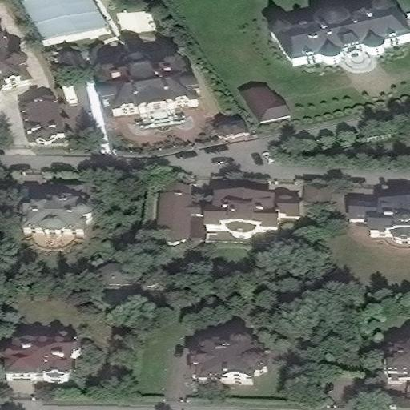
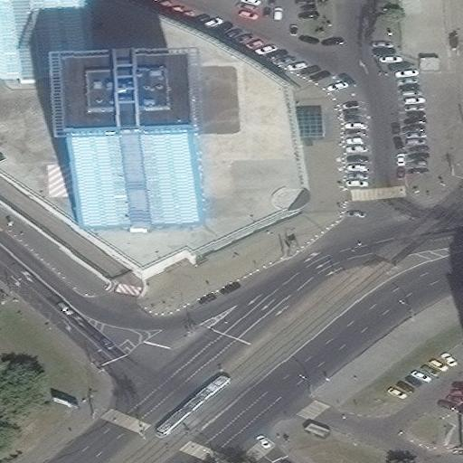
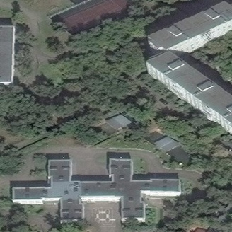
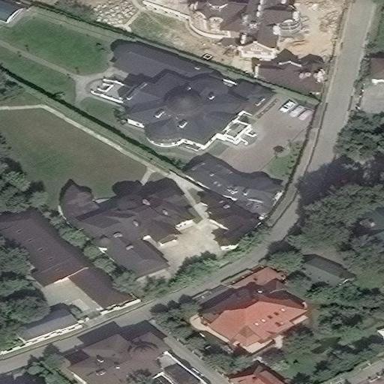
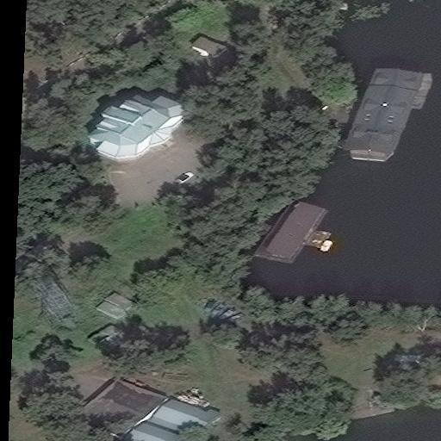
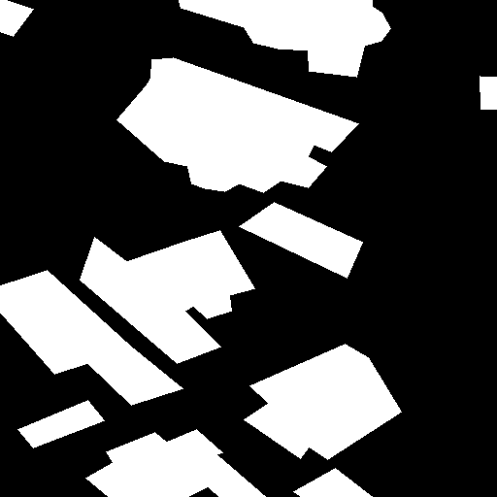
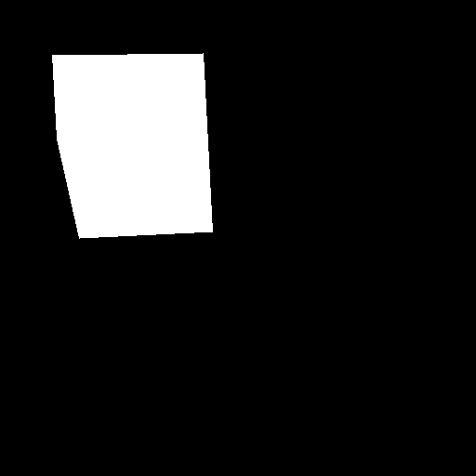
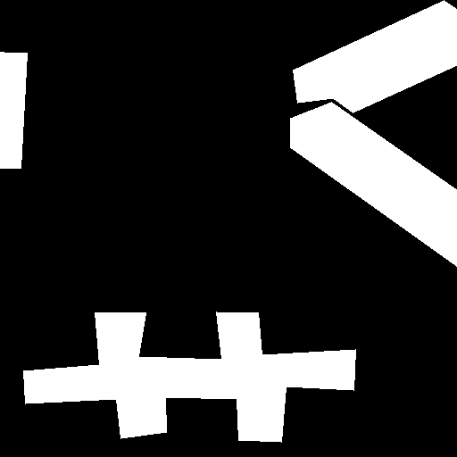

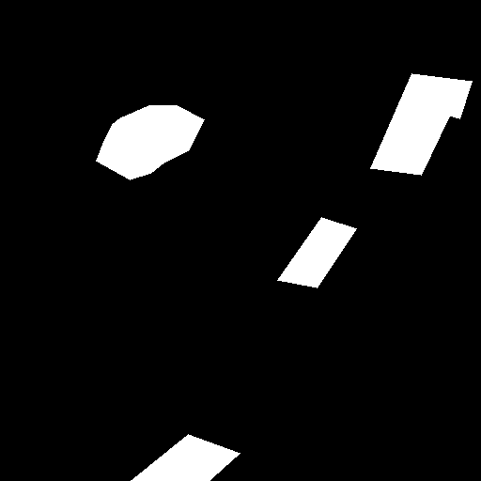
An increase in the training database, the addition of "complex" cases;
Collection of image bases for other endoscopic systems;
Real-time endoscopy processing.
Dataset preparation
Cropped image resolution: 512x512 px
Augmentation: mirror reflection + rotation (+90, +180, -90)
Training set: 20888 images
Test set: 5224 photos

Slide 8
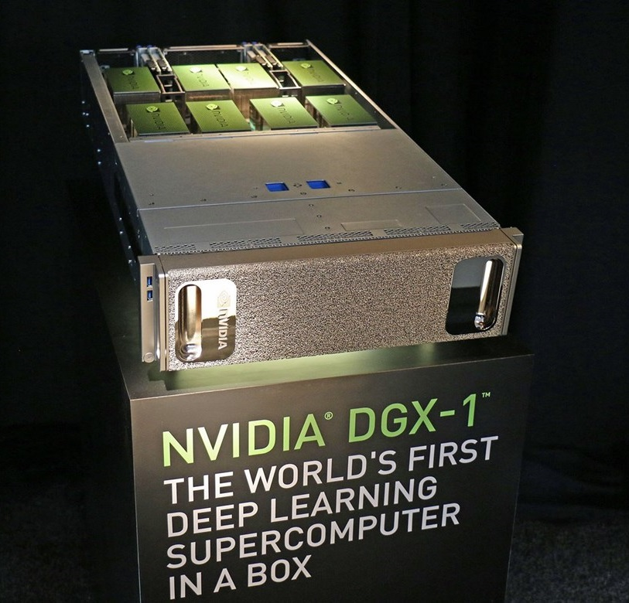

An increase in the training database, the addition of "complex" cases;
Collection of image bases for other endoscopic systems;
Real-time endoscopy processing.
Training process
Metrics: Jaccard index (J)
Loss function: binary cross-entropy
Optimizer: Adam
Batch size: 36 cropped samples
Epochs (E): 100
Time: 4 hours

Slide 9
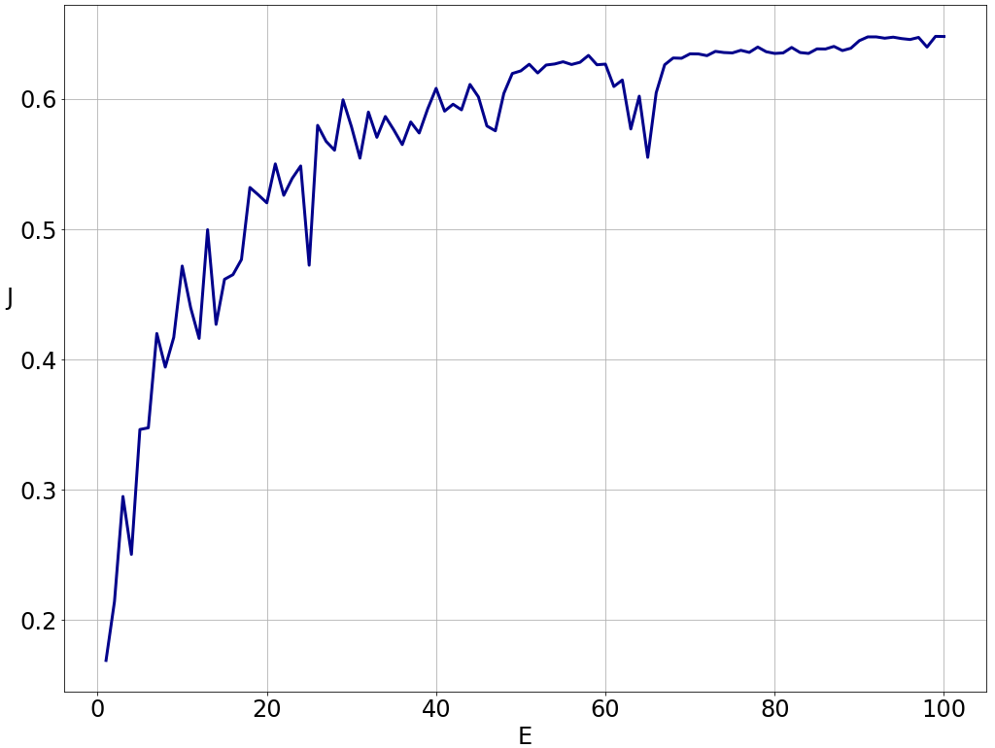
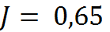
An increase in the training database, the addition of "complex" cases;
Collection of image bases for other endoscopic systems;
Real-time endoscopy processing.
Dependency of Jaccard index on training epochs

Slide 10
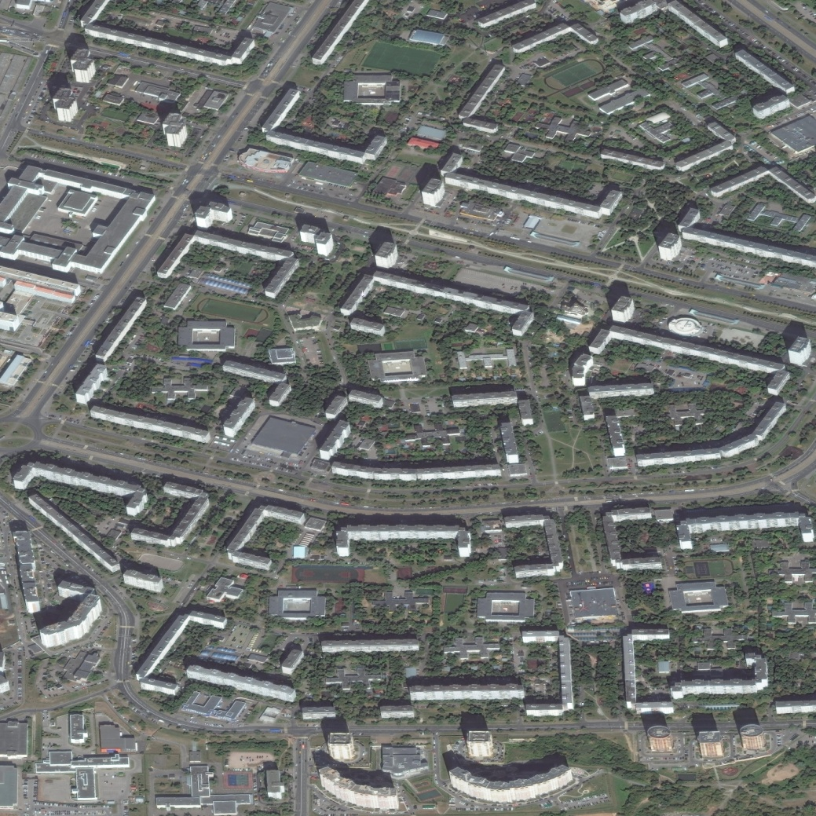
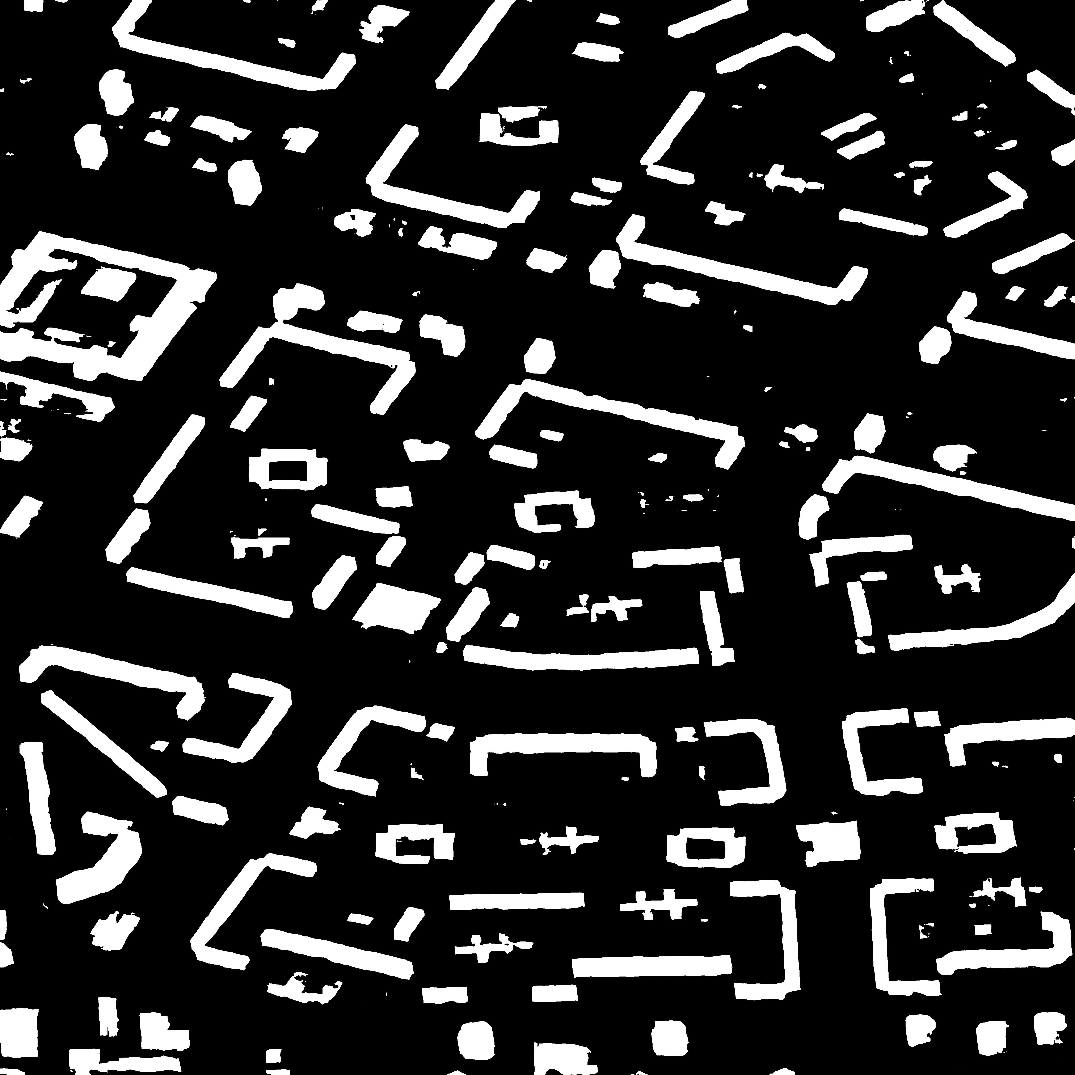
An increase in the training database, the addition of "complex" cases;
Collection of image bases for other endoscopic systems;
Real-time endoscopy processing.
Examples of detection

Slide 11
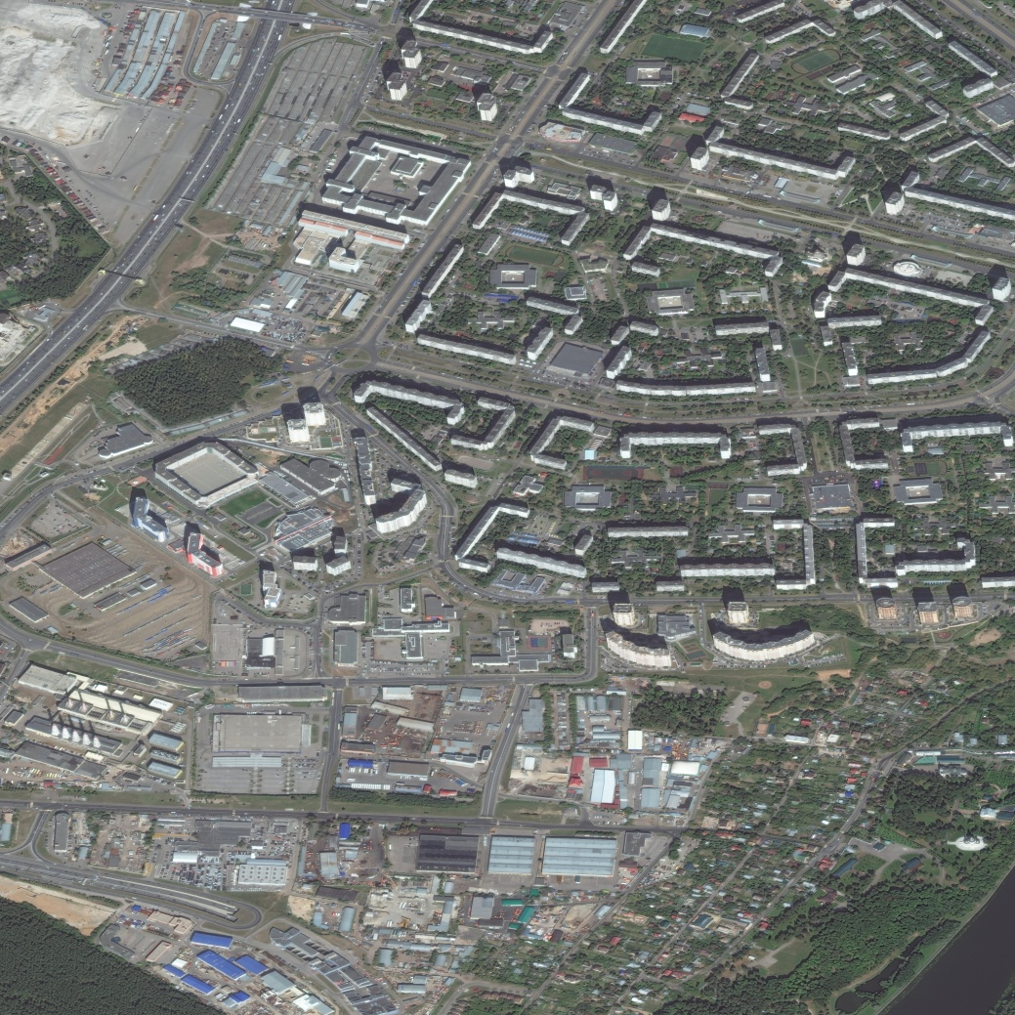
An increase in the training database, the addition of "complex" cases;
Collection of image bases for other endoscopic systems;
Real-time endoscopy processing.
Examples of detection

Slide 12
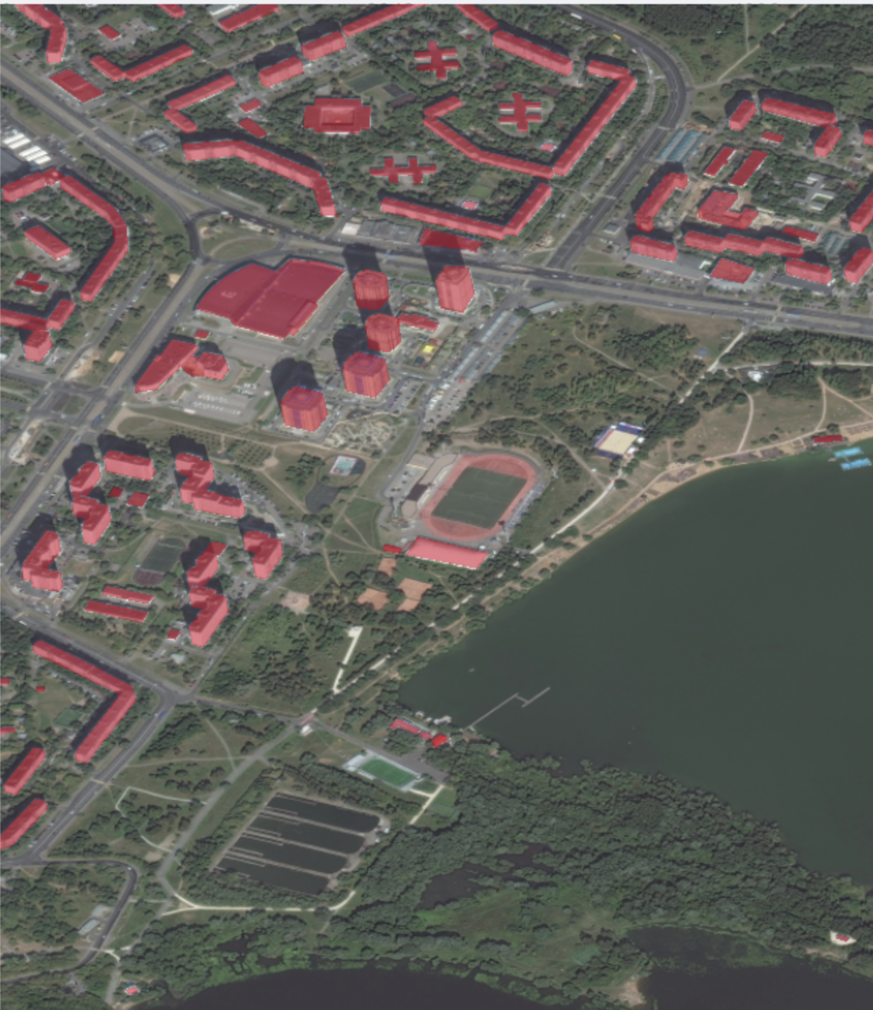
An increase in the training database, the addition of "complex" cases;
Collection of image bases for other endoscopic systems;
Real-time endoscopy processing.
Application
Search best locations for
outlets
Urban planning
Building control

Slide 13
An increase in the training database, the addition of "complex" cases;
Collection of image bases for other endoscopic systems;
Real-time endoscopy processing.
Conclusions
CNNs can be effectively used for building detection on
aerial photos
U-Net was developed to cope with satellite images
segmentation
The training of CNN was carried out on supercomputer
NVIDIA DGX-1
The value of Jaccard index is equal to 0.65

Slide 14
An increase in the training database, the addition of "complex" cases;
Collection of image bases for other endoscopic systems;
Real-time endoscopy processing.
Future plans
Try more complicated loss functions
Detect building corners
Try mask search algorithms (Mask R-CNN, Faster-CNN)
Shift color channels

Slide 15

An increase in the training database, the addition of "complex" cases;
Collection of image bases for other endoscopic systems;
Real-time endoscopy processing.
Acknowledgment
The work was prepared with the financial support of the Ministry of Education of the Russian Federation as part of the research project No. 14.575.21.0167 connected with the implementation of applied scientific research id. RFMEFI57517X0167

